Slide 1

G2M Case Study
Virtual Internship
June 21st, 2022

Slide 2

Agenda
Case Summary
Industry Overview
Database
EDA
Forecasting
Recommendations

Slide 3
G2M Case Study
The Client
XYZ is a private firm in US. Due to remarkable growth in the Cab Industry in last few years and multiple key players in the market, it is planning for an investment in Cab industry and as per their Go-to-Market(G2M) strategy they want to understand the market before taking final decision.
Project delivery:
From an extensive market research and analysis of cab industry data from 2 companies (Yellow Cab and Pink Cab), we hope to assess the pros and cons of the current cab market, its competitive dynamics and future trends
Based on an exploratory data analysis, we give investment recommendations, explaining the potential risks and returns
Case Summary
Industry Overview
Database
EDA
Forecasting
Recommendations

Slide 4
US Cab Industry
Global market: US$ 69 billion in 2019
Expected to reach US$ 120 billion in 2027 (CAGR 12%)
Deeply affected by COVID-19, that changed customer preferences
Market trends:
Growing demand for online cab booking and online payment
Increase of cost of vehicle ownership
Popularization of autonomous and electric vehicles
Increasing competition of ridesharing services (i.e.: Uber)
Government regulation
Improvement of public transportation
Case Summary
Industry Overview
Database
EDA
Forecasting
Recommendations

Slide 5
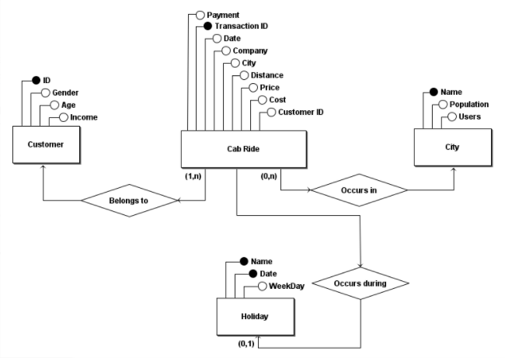
Database
Datasets & Data Preprocessing:
Cab_Data.csv – trip details
Customer_ID.csv – customer information
Transaction_ID.csv – transaction details
City.csv – users and population per city
Final database:
Cab_Data and Transaction_ID were merged
US federal holidays between 2016 and 2018 were added
15 features + 5 added
Profit: price minus cost
Profit margin: profit divided by price
Gain: profit from profitable trips only
Loss: loss from unprofitable trips
Users per 100k inhabitants
Case Summary
Industry Overview
Database
EDA
Forecasting
Recommendations

Slide 6
User Distribution per City
Share of Total Users (pie chart) & Users/100k inhabitants
Is there any geographical concentration on users in the US?
Yes! 6 US cities account for 80% of all cab users in the database
In terms of users per 100k inhabitants, 3 cities stand out: San Francisco, Boston and Washington DC. They have more than 3 times the amount from the 4th place, making them key cities for cab demand
This leads to other hypothesis:
Are there any outliers in terms of km travelled?
Does any of the companies have some kind of geographical dominance?
Case Summary
Industry Overview
Database
EDA
Forecasting
Recommendations

Slide 7
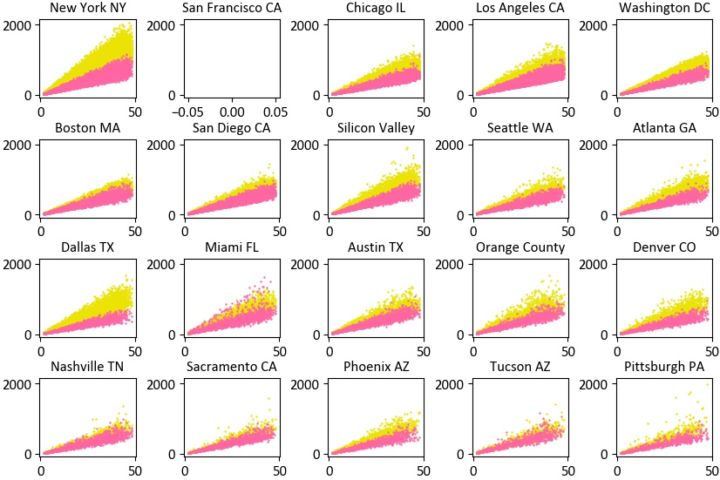
Price of Trip X Distance per city
Share of Total Users (pie) & Users/100k inhabitants
Each yellow point is a trip made by Yellow Cab, while each pink marker is from Pink Cab.
The scatter plot indicate an advantage of Yellow Cab, that is able to charge higher prices per trip, regardless of the km traveled.
This pattern is very clear except in cities with few users (such as Tucson and Sacramento), but even on those we can see an advantage from Yellow.
OBS.: The database does not have any data on trips in San Francisco, a key city in the US market, which brings uncertainty to the analysis.
Case Summary
Industry Overview
Database
EDA
Forecasting
Recommendations

Slide 8
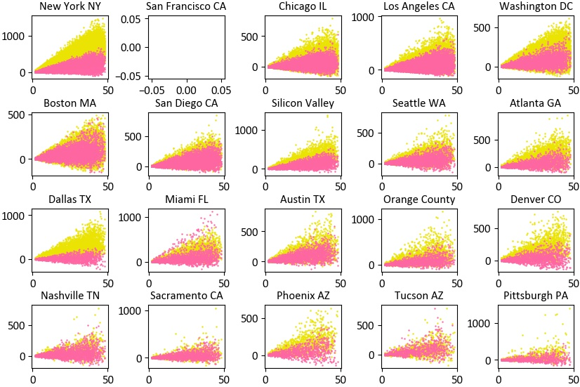
Profit X Distance per city
Share of Total Users (pie) & Users/100k inhabitants
Higher prices don’t necessarily mean higher profits, but in that case they do: Yellow Cab is more profitable in every city on the database.
The combination of higher prices and costs indicates that Yellow Cab provides a more premium service than Pink Cab.
This might be explained by market dynamics. Since the cab industry is facing agressive competition from ridesharing companies like Uber, premium taxi services may generate more value for customers than cheap cab trips, which are more easily replaced by the new entrants.
Case Summary
Industry Overview
Database
EDA
Forecasting
Recommendations

Slide 9
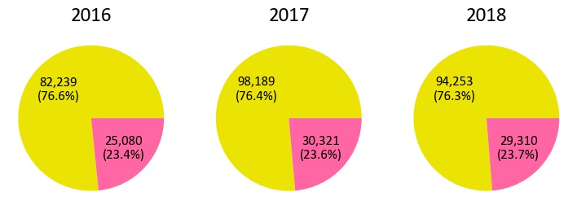
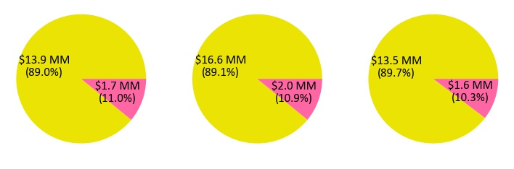
Cab Trips
Number of Trips & Total Profit (US$ million)
If Yellow Cab’s service is more premium and costly, it must have fewer clients. How does the company balance this in order to profit?
Surprisingly, although providing a premium service with higher prices, Yellow Cab maintained a 76% share of total trips during the 2016-2018 period.
This is another important datapoint for Yellow Cab's advantage, since it beats Pink Cab in both number of rides and profitability per ride.
As Yellow Cab has more trips and profitable ones, it accounts for 90% of all profit during the period
The number of rides and profit margin remained constant during the period, indicating the low growth of the cab industry.
Case Summary
Industry Overview
Database
EDA
Forecasting
Recommendations

Slide 10
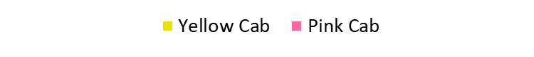
Cab Trips
Year | Total Trips | Total Profit (million US$) | Average Profit (US$) | Average Cost (US$) | Average Distance | Profitable Trips | Average Gain (US$) | Unprofitable Trips | Average Loss (US$) | Average Profit Margin
2016 | 25,080 | 1.71 | 68.32 | 247.01 | 22.5 | 21,839 | 81.72 | 3,241 | 21.97 | 22%
 | 82,239 | 13.93 | 169.35 | 298.57 | 22.6 | 78,353 | 178.74 | 3,886 | 20.08 | 36%
2017 | 30,321 | 2.03 | 67.07 | 248.84 | 22.6 | 25,959 | 82.01 | 4,362 | 21.82 | 21%
 | 98,189 | 16.58 | 168.82 | 297.82 | 22.6 | 93,094 | 179.20 | 5,095 | 20.84 | 36%
2018 | 29,310 | 1.56 | 53.23 | 248.41 | 22.6 | 25,784 | 62.85 | 3,526 | 17.10 | 18%
 | 94,253 | 13.52 | 143.42 | 297.46 | 22.5 | 89,544 | 151.79 | 4,709 | 15.90 | 33%
The table above summarizes the numbers that show Yellow Cab’s competitive advantage from its peers.
Profit: although average profit has been decreasing due to market dynamics, Yellow’s numbers are 2.7x times Pink’s in 2018, versus 2.5x in 2016, meaning that Yellow is more resilient to systematic risk and ridesharing competition.
Distance: both companies have the same average trip distance, reinforcing the idea that Yellow Cab provides a more premium and valuable service.
Unprofitable trips: Pink Cab made almost 50% of all trips that lost money, despite making only 24% of the trips. This means that 13% of Pink’s rides are unprofitable, versus 5% of Yellow’s.
Margin: while overall profit margin has been decreasing, Yellow Cab still outperforms Pink Cab, reaching a number 84% higher than its competitor in 2018, vs. 67% in 2016.
Case Summary
Industry Overview
Database
EDA
Forecasting
Recommendations

Slide 11
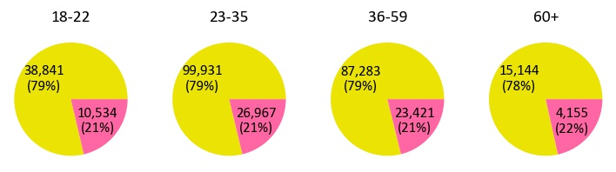
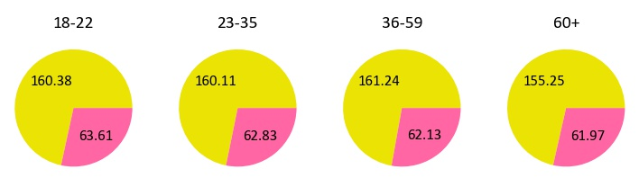
Customer Profile
Trips & Average Profit (US$) per Age Group
Data shows that customer profile is very homogenous throughout the database.
Age group: 78% of the trips are made for customers between 23 and 59 Years old, and there is no significant difference in terms of profitability depending on age group. Yellow Cab’s average profit margin is more than 2.5x Pink Cab’s in all age groups.
Gender: Similar gender profile for both companies
Case Summary
Industry Overview
Database
EDA
Forecasting
Recommendations

Slide 12
Customer Preferences
Number of Customers |  | Payment
 |  | More Card | Indifferent | More Cash
Company | Yellow | 12,151 | 1,140 | 2,957
 | Indifferent | 444 | 165 | 97
 | Pink | 1,503 | 157 | 515
Profit Margin (%) |  | Payment
 |  | More Card | Indifferent | More Cash
Company | Yellow | 34.9 | 28.6 | 30.8
 | Indifferent | 23.4 | 23.3 | 23.9
 | Pink | 22.7 | 22.5 | 22.5
How does customer preference affect profitability and demand? Do company/payment preferences play a role on the companies’ performance?
The matrixes indicate the number of customers or average profit margin for each combination of preferences (OBS.: Only customers with at least 5 trips were considered)
75% of Yellow’s clientes prefer to pay by card while 18% prefer by cash, versus 69/24% of Pink Cab. This shows that Yellow Cab is better placed to benefit from market trends regarding online booking, ridesharing competition and non-cash payments than Pink Cab.
Another important fact extracted by the matrix is that 85% of customers with at least 5 trips prefer Yellow Cab, while only 11% prefer Pink Cab
Moreover, it is curious to see that card preference leads to higher profit margin than cash (regardless of company preferences), meaning that card payers are willing to pay more for the rides. This corroborates the market trends expected for de cab industry.
Case Summary
Industry Overview
Database
EDA
Forecasting
Recommendations

Slide 13
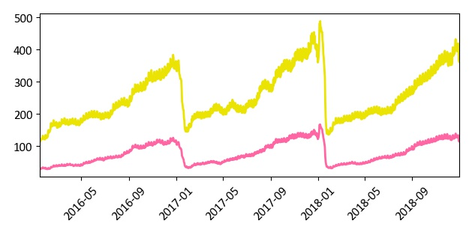
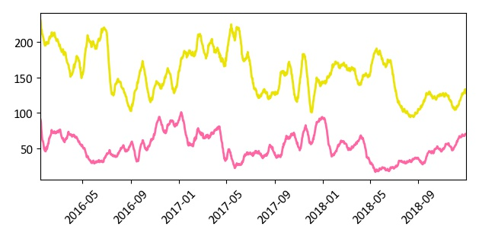
Time Series Analysis
Daily Trips – 15-day Moving Average
Daily Average Profit (US$) – 15-day Moving Average
The evolution of the number of trips per day during the 2016-2018 period indicates a very strong seasonality for both companies. The demand for cab rides increases in a very steady pace throughout each year, followed by a sharp decrease after New Year’s Eve. The demand for Yellow Cab’s service is much higher than Pink Cab’s during the whole period.
Profit evolution is less seasonal and indicated the loss of profitability of the overall industry, due to ridesharing competition and other previously explained factors than increase systematic risk.
In both images, it is clear that the Yellow Cab's advantage is strong and constant throughout the whole year
Case Summary
Industry Overview
Database
EDA
Forecasting
Recommendations

Slide 14
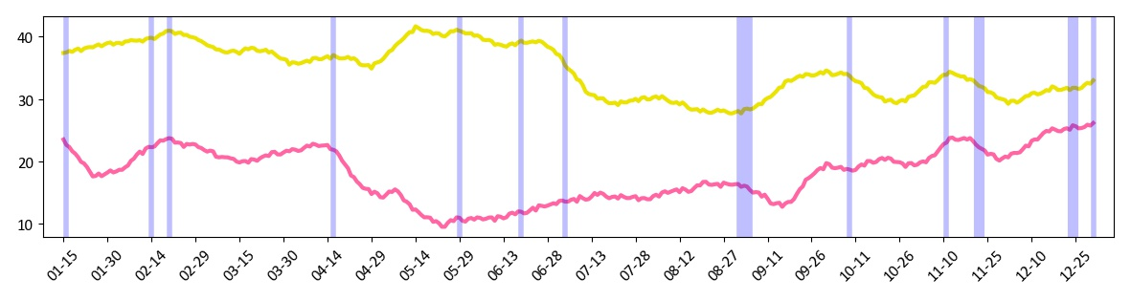
Time Series Analysis
Daily Average Margin Profit (%) – 15-day Moving Average
As shown before, Yellow Cab’s average profit margin are far superior than Pink's throughout the whole year
Both companies’ margins seem to respond similarly to holidays, with increasing trends before and decreasing trends after them. The main difference can be seen after Easter, when Yellow Cab’s margin increases while Pink Cab’s sharply drops. This partially explains Yellow Cab’s higher profits during the 2nd quarter of each year (plot from the previous slide).
Since the fluctuations are very similar, it is safe to conclude that the companies are subject to the same systematic risk and factors, so there are idiosyncratic factors that gives Yellow Cab a greater performance.
Case Summary
Industry Overview
Database
EDA
Forecasting
Recommendations

Slide 15
2019 Profit Forecasting
Forecasting Asssumptions:
Number of Trips: The growth will be equal to the US population growth rate, estimated to reach 355 million in 2030 - ~1% annual rate (https://www.census.gov/content/dam/Census/library/publications/2020/demo/p25-1144.pdf)
Average price per trip:
Baseline Scenario: since market trends seem negative and the US inflation rate is growing, I assumed a steady price (0% growth)
Pessimistic: 2016-2018 CAGR of -2.2% and -2.9% for Pink Cab and Yellow Cab, respectively
Optimistic: competition won't decrease prices, that will grow with US inflation - 3.30% per year (https://ycharts.com/indicators/us_expected_changes_in_inflation_rates_next_five_years#:~:text=Basic%20Info,long%20term%20average%20of%203.21%25)
Profit Margin:
Baseline: margin will recover partially from 2018 – 20% and 34% for Pink Cab and Yellow Cab, respectively
Pessimistic: margin will continue to decrease due to competition and customer changed preferences after COVID-19 – 15% and 29% for Pink Cab and Yellow Cab, respectively
Optimistic: both Yellow and Pink will return to 2016 numbers of 36% and 22%, respectively
Case Summary
Industry Overview
Database
EDA
Forecasting
Recommendations

Slide 16
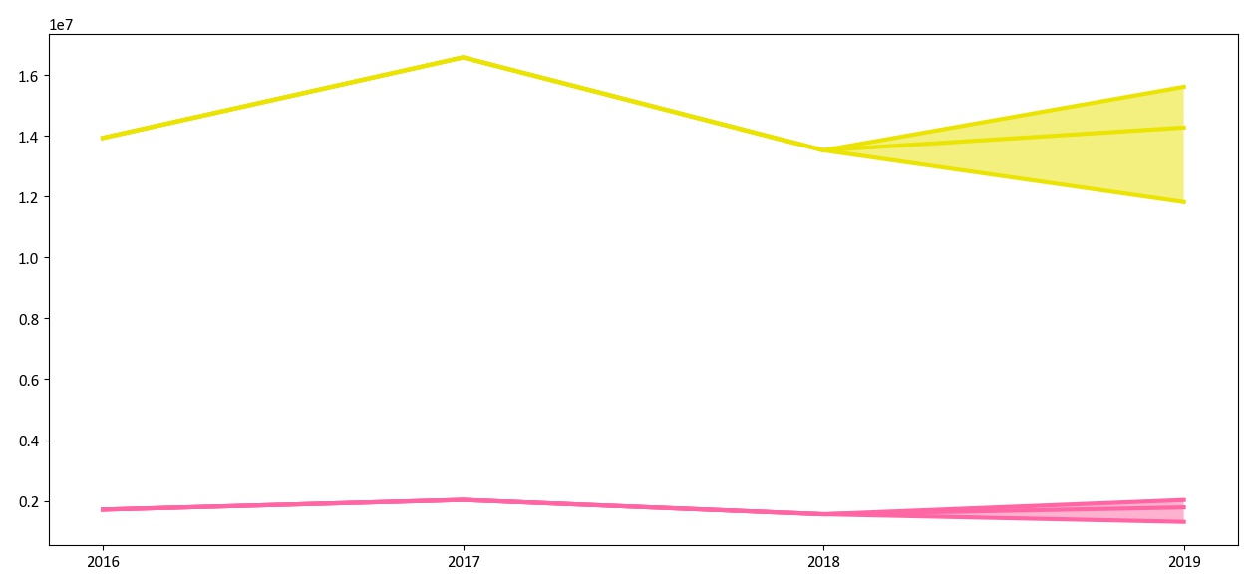
2019 Profit Forecasting
2019 Profit Forecast Scenarios
As shown before, Yellow Cab’s average profit margin are far superior than Pink's throughout the whole year
Both companies’ margins seem to respond similarly to holidays, with increasing trends before and decreasing trends after them. The main difference can be seen after Easter, when Yellow Cab’s margin increases while Pink Cab’s sharply drops. This partially explains Yellow Cab’s higher profits during the 2nd quarter of each year (plot from the previous slide).
Since the fluctuations are very similar, it is safe to conclude that the companies are subject to the same systematic risk and factors, so there are idiosyncratic factors that gives Yellow Cab a greater performance.
Case Summary
Industry Overview
Database
EDA
Forecasting
Recommendations

Slide 17
Conclusion
Industry Overall: the cab industry is facing many challenges that affect long-term profitability, such as increasing competition with ridesharing companies (i.e.: Uber) and government regulation
Price Charged: Yellow Cab’s premium service allows them to charge 48% more than Pink Cab
Number of Trips: despite higher prices, Yellow Cab’s total trips were more than triple than the number of rides made by Pink Cab
Profit: Yellow Cab’s annual profits are more than 8 times Pink Cab’s, with a 150% higher profit per ride and proportionally fewer unprofitable trips (5% of all trips, versus 13% of Pink Cab)
Margin: overall profit margin has dropped significantly, but Yellow Cab’s margin is 84% higher than Pink Cab’s and decreased less (-10% versus -19% of Pink Cab)
Seasonality: Yellow Cab better responds to seasonality and performs better after holidays than Pink Cab
Forecasting: baseline growth for 2019 is slightly positive due to poor market conditions, but Yellow Cab shows much more potential upside if the company is able to fight ridesharing competition with its premium service.
After analyzing these and other aspects, we recommend the investment on Yellow Cab, since the company consistently outperforms its competitors and is more resilient to market changes and is better placed to maintain profitability in a very competitive industry.
Case Summary
Industry Overview
Database
EDA
Forecasting
Recommendations

Slide 18
Thank you!

